Slide 1
BackTrack
Ashley Lindsey
Daniel Hua
Mike Stepanovic
Yuqian Sun
Notes:
7min time limit.
Needed slides:
Title: A short, creative, and marketable title capturing the key idea. Include team member names, and optionally include roles.
Overall Problem: Tell this as a story, instead of simply reading the slide. Motivate your audience to be interested in your problem.
Design Research: Include images that give your audience a feeling for your fieldwork. Convey that you have seen and understand the challenge.
6 Tasks: At most one sentence per task. Convey the breadth of tasks you have considered.
3 Design Sketches: Convey the breadth of designs you considered.
Selected Design Storyboards and Tasks: Convey your rationale for choosing a design focus. Present your storyboards, ensuring they effectively illustrate your selected design and tasks.
Summary: Summarize the lessons learned in your design process.

Slide 2



Posture is Impactful
Design Problem
Physical
Health
Mental
Health
Impression
Good posture gives merits to various factors
Notes:
Physical Health: back pain, difficulty in respiration
Mental Health: upright has more positive emotion
Impression: upright people looks confident, energetic

Slide 3
Posture is Impactful
Design Problem
We are almost always unaware of our posture.
Physical
Health
Mental
Health
Impression
Good posture gives merits to various factors
Notes:
Physical Health: back pain, difficulty in respiration
Mental Health: upright has more positive emotion
Impression: upright people looks confident, energetic

Slide 4
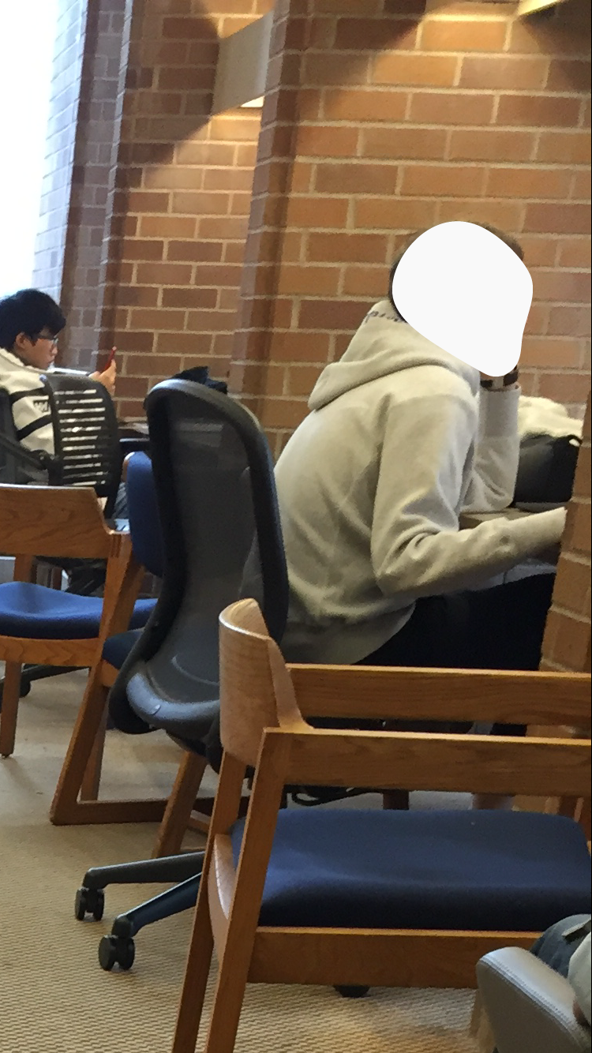
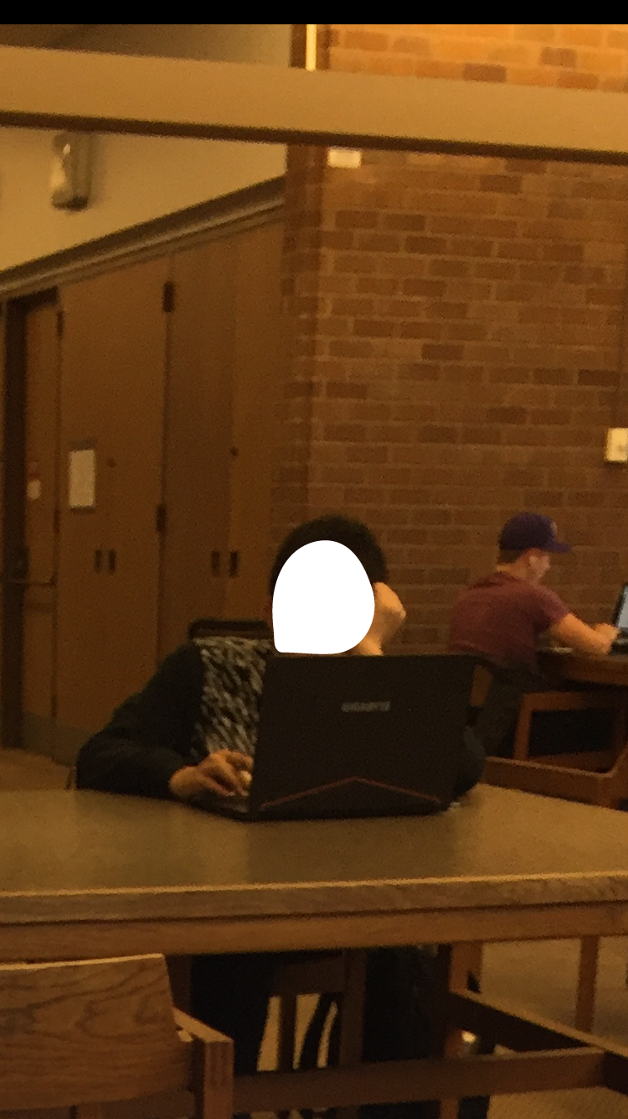
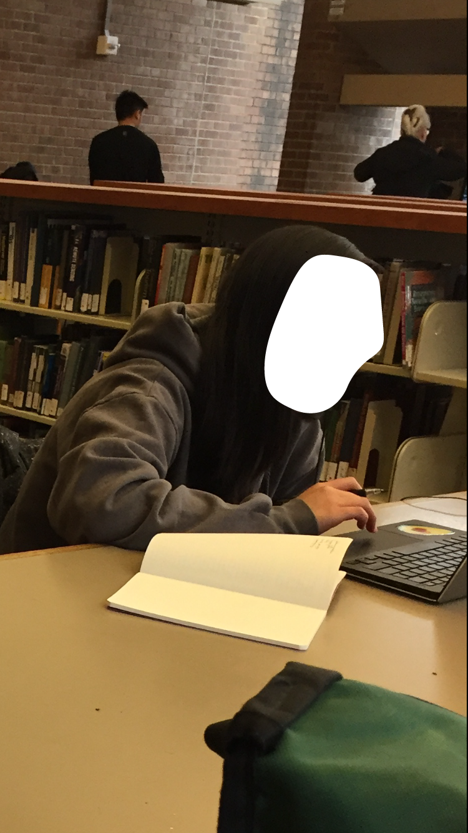
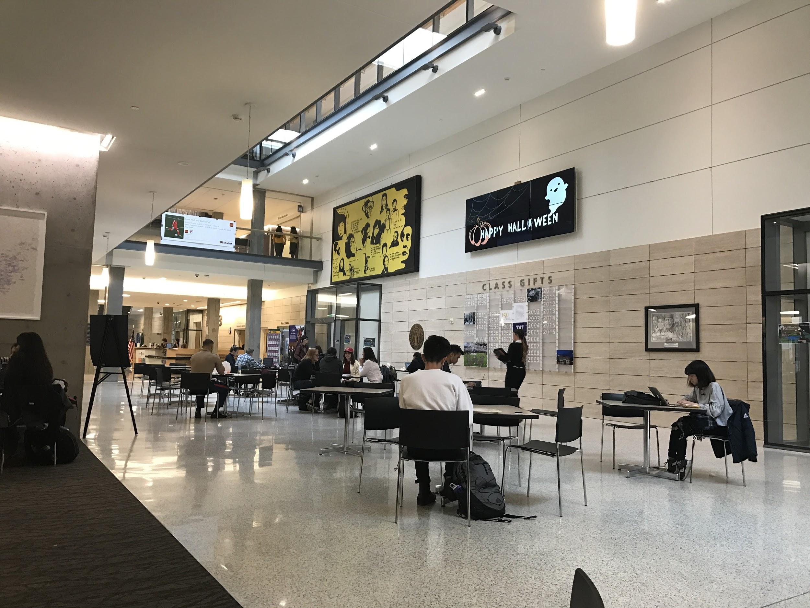
Method 1: Fly on the Wall Observations
Research Method
Locations
Seattle Public Library, University District Branch
Odegaard Library
Grouphealth
Husky Union Building
Northgate Mall Food Court Center
Figure 1: Odegaard Library
Figure 2: Husky Union Building
Notes:
In total observe more than 30 participants
People seated at the desk

Slide 5
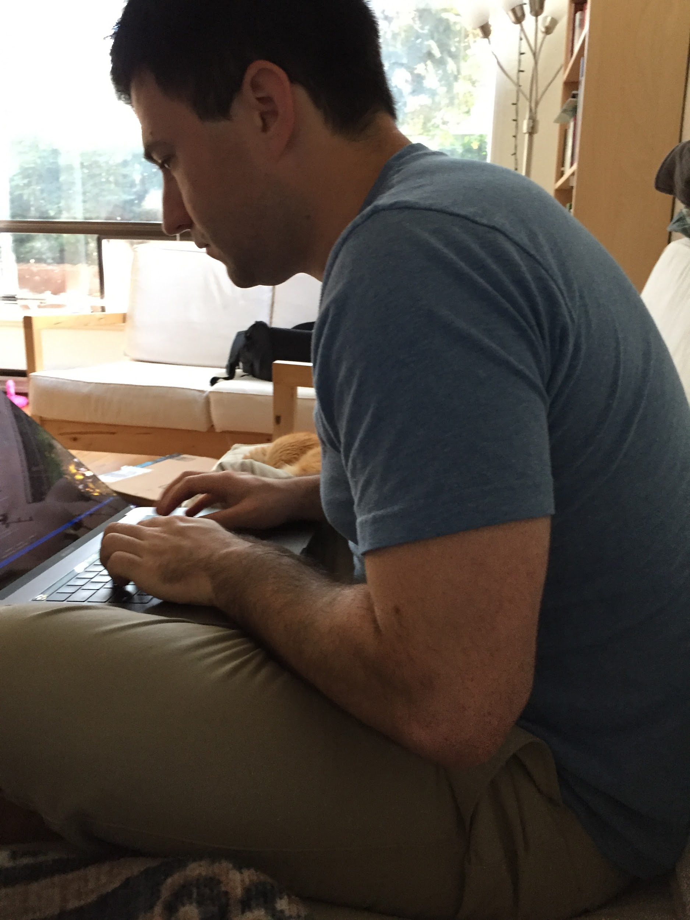
Method 2: Contextual Inquiry
Research Method
Participants
Male, 29, Software Engineer from Seattle, WA
Female, 23, Bioengineering Student at UW
Procedure
Start recording
Ask participants to do work with their laptop
Tell the true purpose
Ask questions while watching the record
Figure 3: Participant doing deskwork
Notes:
We covertly videotaped participants working at a desk for as long as it takes for them to adjust their posture in a negative way
Show the record

Slide 6

Method 3: Experience Sampling
Research Method
Participants
Female, 26, Medical School Student at Saint Louis University
Female, 24, American Studies Student at UW
Male, 21, American Studies Student at UW
Male, 18, Computer Science & Engineering Student at UW
Male, 18, Computer Science & Engineering Student at UW
Procedure
Send participants 4 texts per day for 2 consecutive days
Hi, this is the UW Posture Group. Please reply with:
(1) your current location
(2) how many people you are with
(3) your current activity
(4) how you would rate your current posture on
a 3-point scale (1=bad, 2=neutral, 3=good).
Notes:
to learn if certain temporal, spatial, or social contexts influence posture

Slide 7
Five Key Research Findings
Research Results
Determined subconsciously
Posture is...
Corrected with repeated effort
Developed habitually
Harmed by a sedentary lifestyle
Harmed by
stressful activities
Notes:
decided subconsciously.
People don’t realize they have bad posture until it’s too late
developed habitually.
Good and bad posture corresponds with what a person is doing. It helps them do what they want.
harmed by stressful activities.
Thinking intently something often causes people to hunch over or touch their chin, which has a negative impact on posture
harmed by sedentary tasks.
Sitting down is worse for posture than standing. However, doing either for an extended duration drains energy from your muscles and weakens your physical position
corrected with repeated effort.
Addressing posture in real-time helps strengthen the muscles that support a healthy posture. This also defends against “posture creep” in the future.

Slide 8
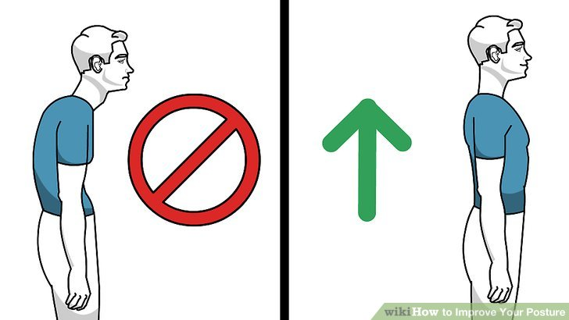
Six Design Tasks
Design Method
Wanting to appear more confident with better posture
Reducing back pain and stiffness when sitting
Trying to be more aware of “posture creep”
Discovering which activities trigger posture habits
Maintaining a healthy viewing angle with screens
Transferring good posture between activities

Slide 9
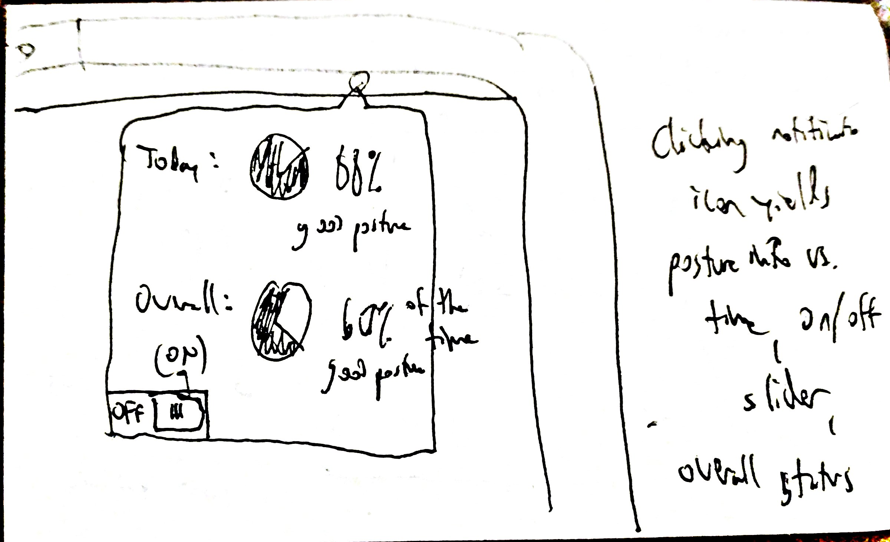
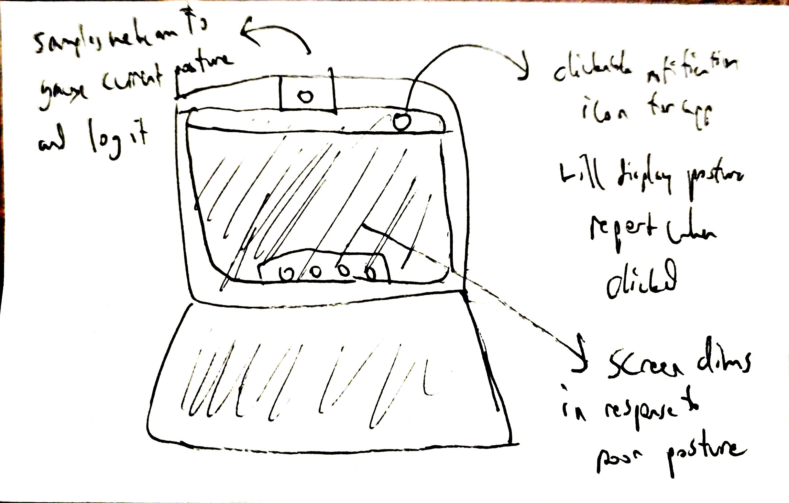
Sketch 1: Laptop Webcam app
Design Method
Uses webcam input from user’s laptop to judge current posture and log it
Clickable notification icon for app will display posture report when clicked
Clicking notification icon opens posture information (time, percentages, etc.) Also allows for on/off toggle, overall status
Screen dims in response to poor posture
Figure 4: Laptop Webcam app
Notes:
Samples webcam to gauge current posture and log it
Clickable notification icon for the app in the top menu, which displays a posutre report when clicked
The screen dims in response to poor posture
Clicking notification icon yields posture info vs. time, an on/off slider, and overall status.
Graph: Today, 88% good posture. Overall: good posture 60% of the time.
Off/(ON)

Slide 10
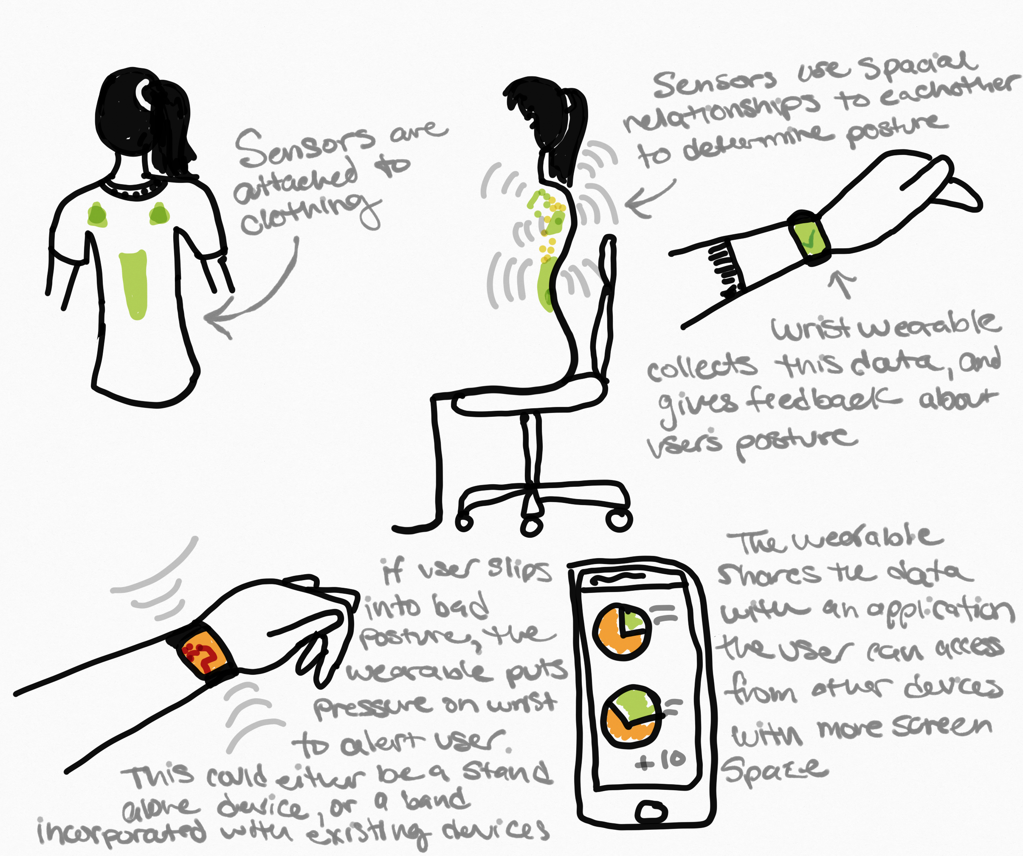
Sketch 2: Wearable Device
Design Method
Figure 6: Wearable Device

Slide 11
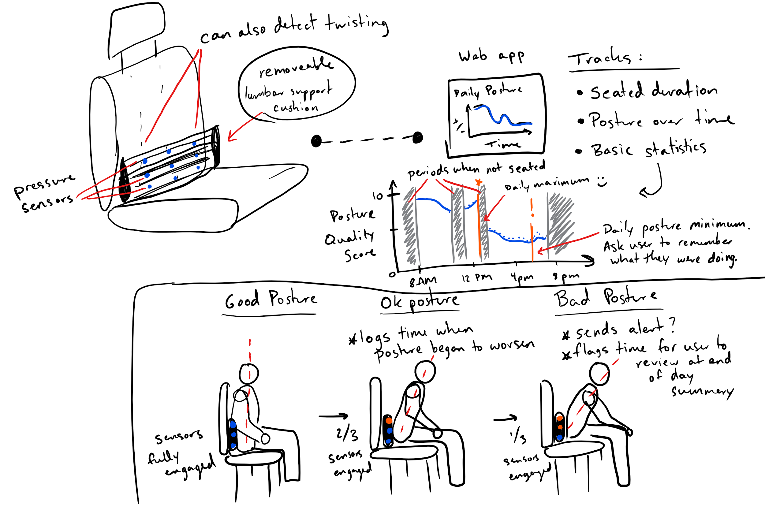
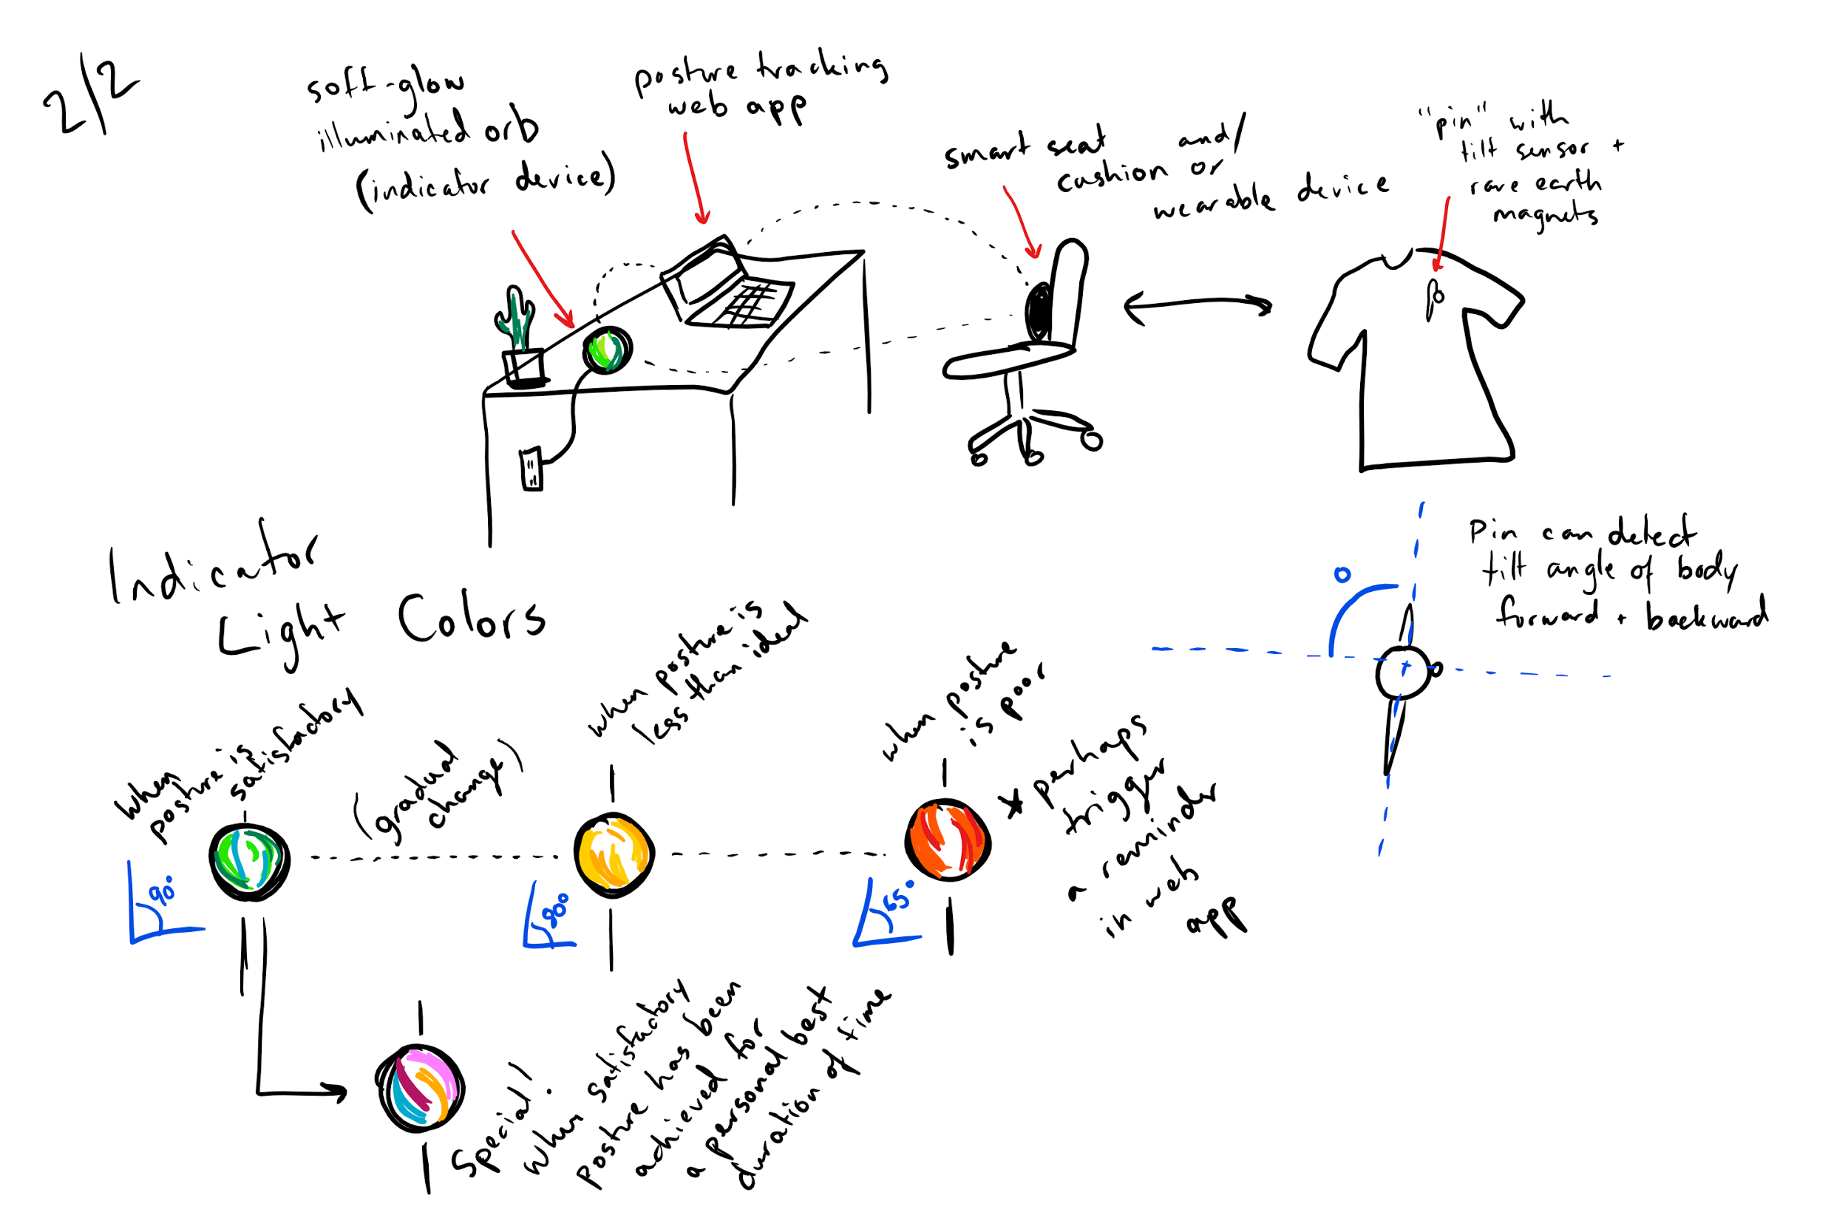
Sketch 3: Posture Light
Design Method
Figure 6: Design of seat with Sensor
Figure 7: Notification Light

Slide 12
Our Selected Design
Design Method
Why we chose wearable posture reminder?
Supports BOTH of the two tasks we considered critical for our user group
Becoming aware of “posture creep”
Adapting to changing activities
Possibility for integration with existing devices (ex. mobile phones, Apple watches)

Slide 13
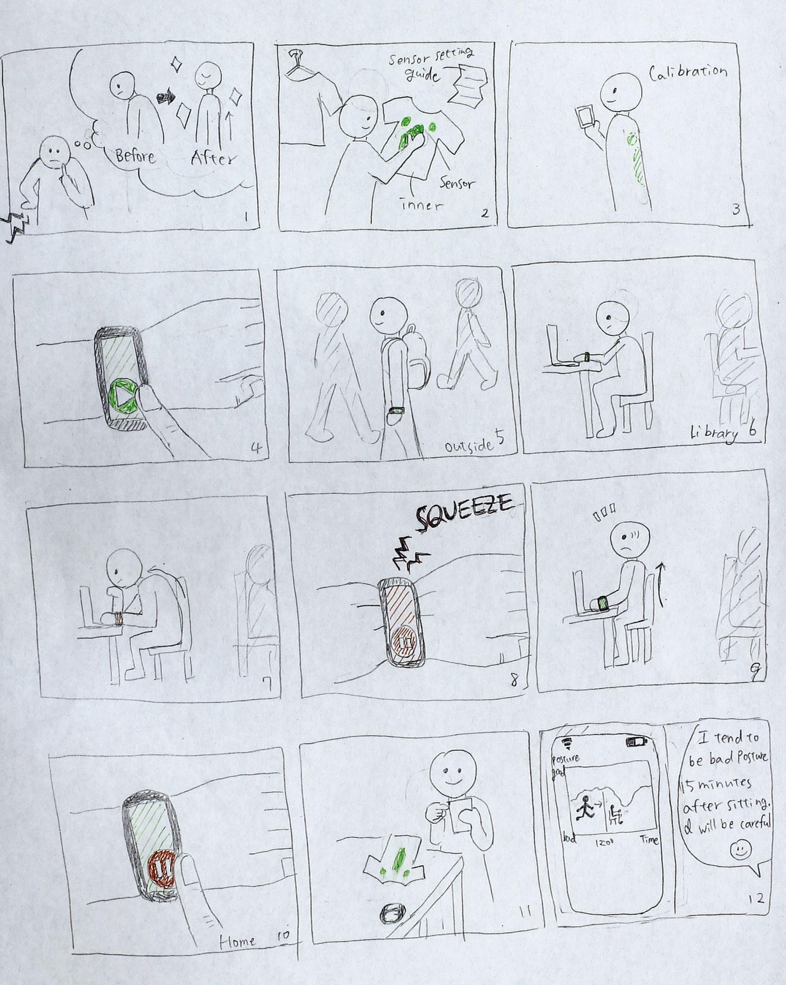
Storyboard 1
Design Method
Becoming Aware of “Posture Creep”
Notes:
Attach the sensor to the clothe
Stay as usual
Check the record of behavior and posture

Slide 14
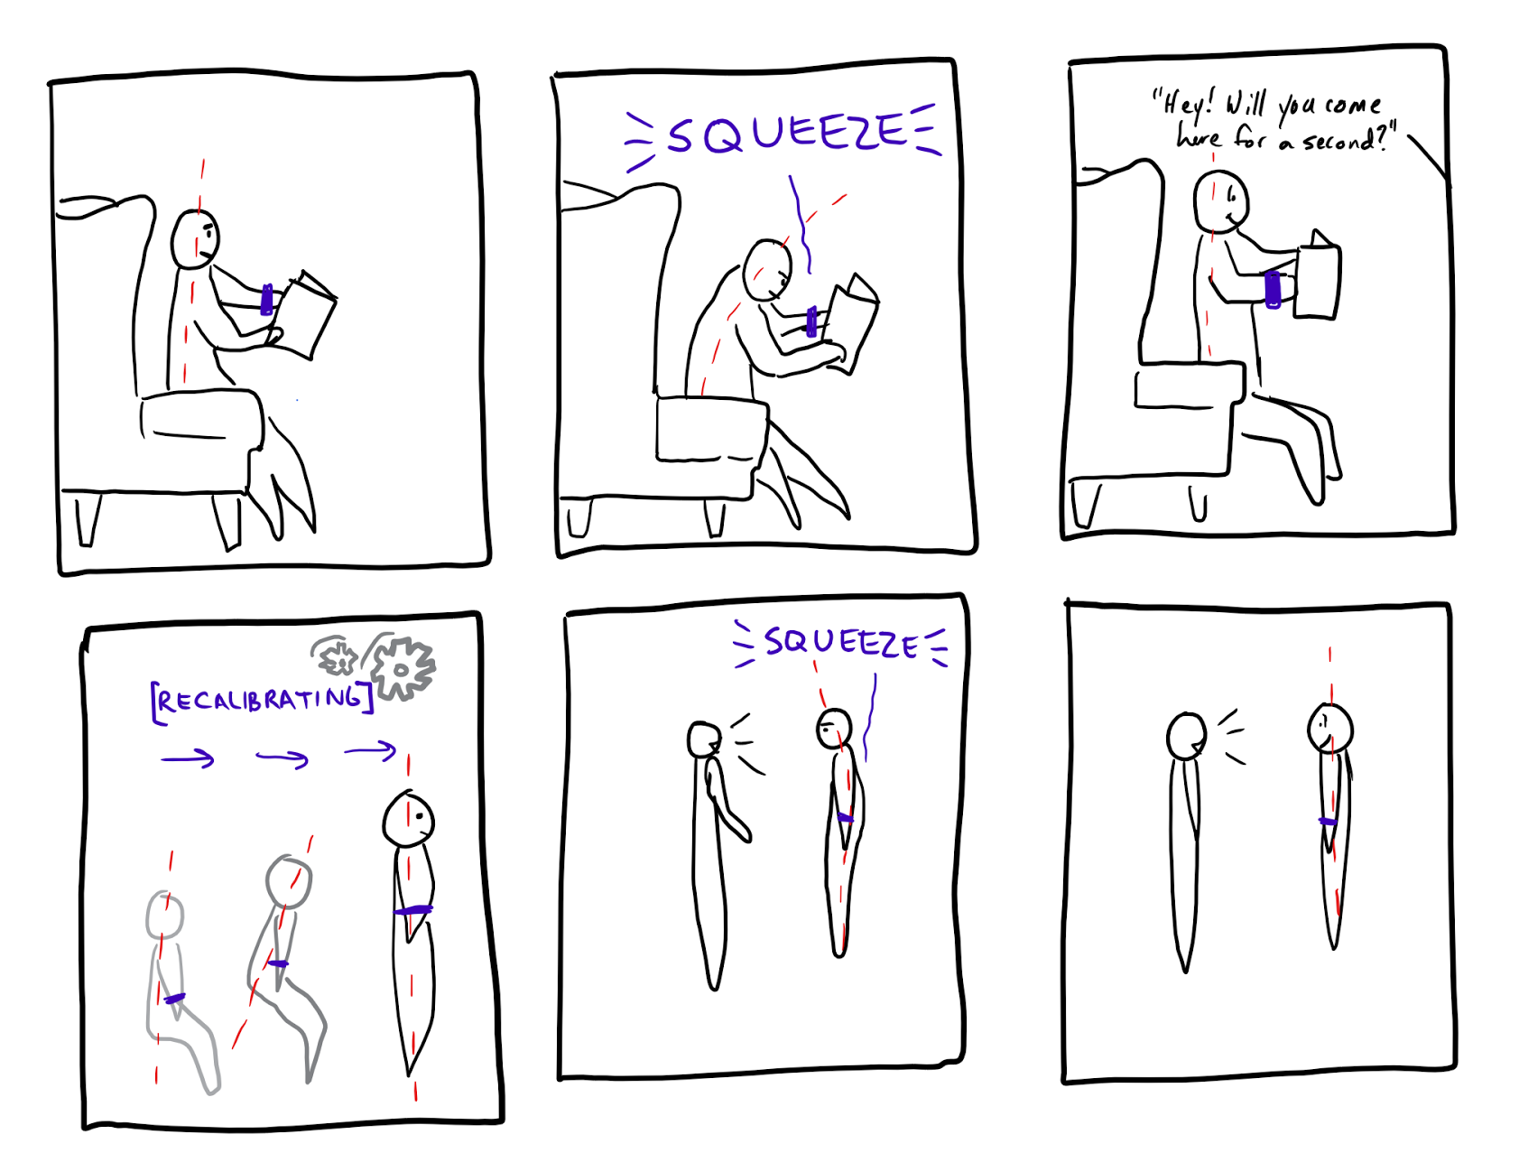
Storyboard 2
Design Method
Adapting to Changing Activities

Slide 15
Lessons Learned in the Design Process
It’s easier to design for a specific group of people than the entire human population.
Getting the tasks right is critical in coming up with the right design
Multiple research techniques allowed us to get better perspective on this open-ended problem

